Slide 1
Viterbi Explained

Slide 2
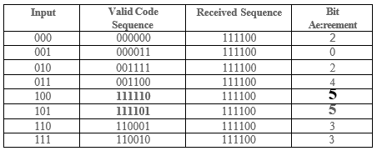
The basic idea behind decoding
3 bits sent via rate ½ => receive 6 bits, with or without errors.
Each 3 bit input has a unique 6 bit output. Valid patterns = 8 out of 64 possible.
Decoder needs to determine most likely 3-bit sequence.
Bit Agreement = metric to among 8 possible valid code sequences

Slide 3
Maximum Likelihood/Viterbi Decoding
Errors must be infrequent.
Two errors in a row must be extremely rare.
Viterbi decoder examines entire received sequence of a given length.
Computes metric for each path and makes a decision based on this.
All paths are followed until two paths converge on one node.
Keep path with the higher metric
For an N bit sequence, total number of possible received sequences = 2N, of which only 2kL are valid.
The Viterbi algorithm limits the comparison to 2^{kL} surviving paths instead of checking all paths.

Slide 4
Hamming Metrics: Metric=2 --> match
Bits Received | Valid Codeword 1 | Valid Codeword 2 | Metric 1 | Metric 2
00 | 00 | 11 | 2 | 0
01 | 10 | 01 | 0 | 2
10 | 00 | 11 | 1 | 1

Slide 5
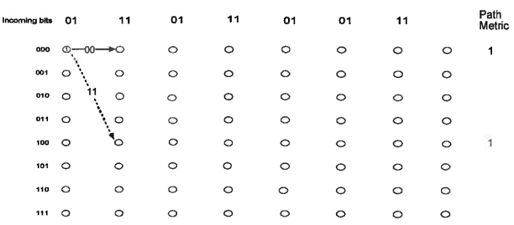
Step 1 Notation: dotted = 1 incoming from left
Metric = 1 for both branches (compare 01 t0 00 and to 11)

Slide 6
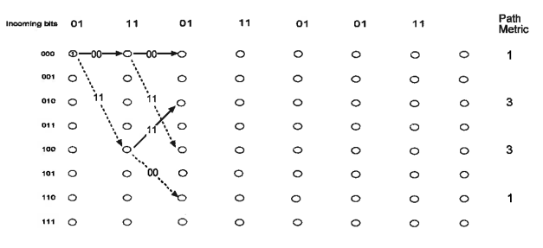
Step 2: middle paths have 1 mismatch

Slide 7
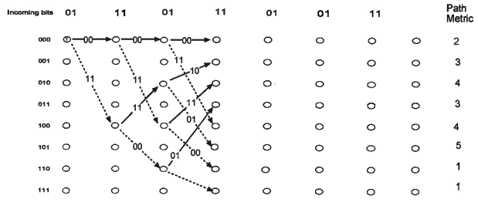
Last chance step w/o pruning

Slide 8
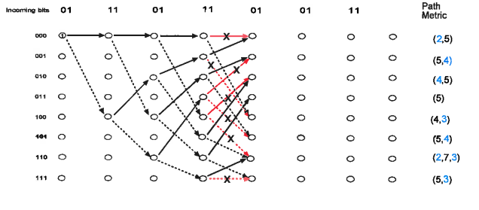
At each node, keep the winner

Slide 9
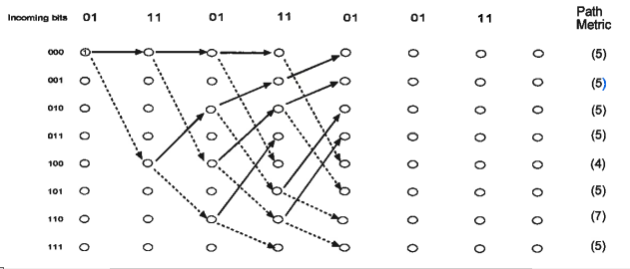
Cleaned up a bit

Slide 10
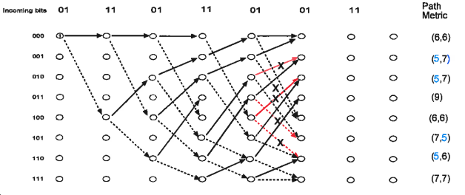
Rinse and Repeat ...

Slide 11
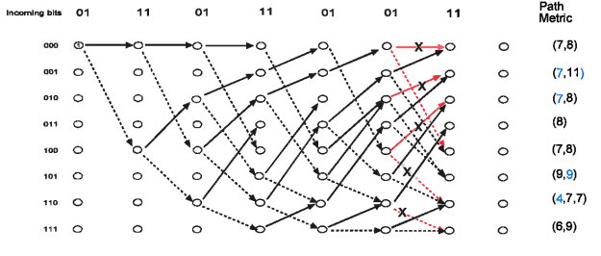
Winner is starting to emerge

Slide 12
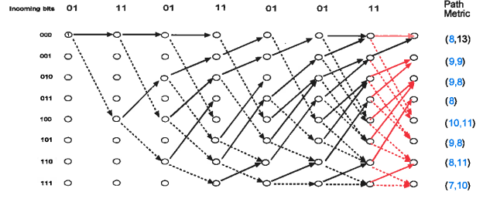
Top path wins States 000 100 010 101 110 011 001 000 Orig msg 1 0 1 1 0 0 0

Slide 13
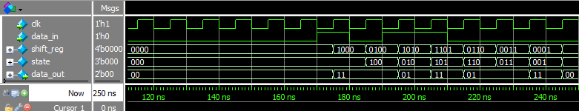
Enconder/Transmitter Simulation
Simulation result for constraint length 7, rate 1/2 convolutional encoder with taps (octal) [1]5 and [1]7. (The [1]s denote the dependence of the output on the input, as well as the current state.)

